Slide 1
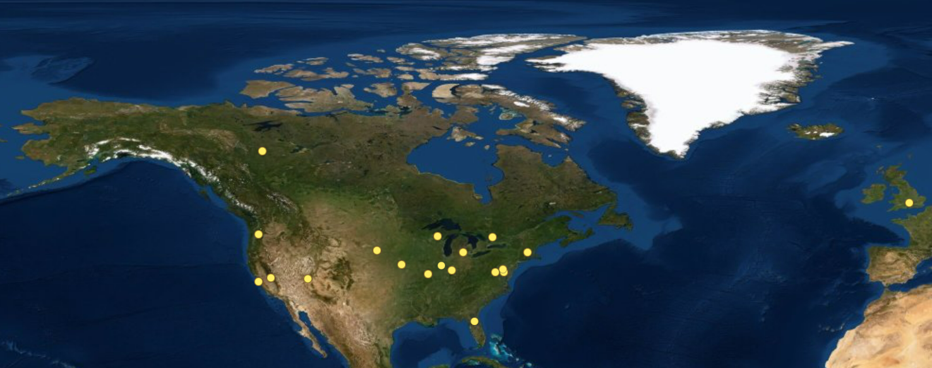
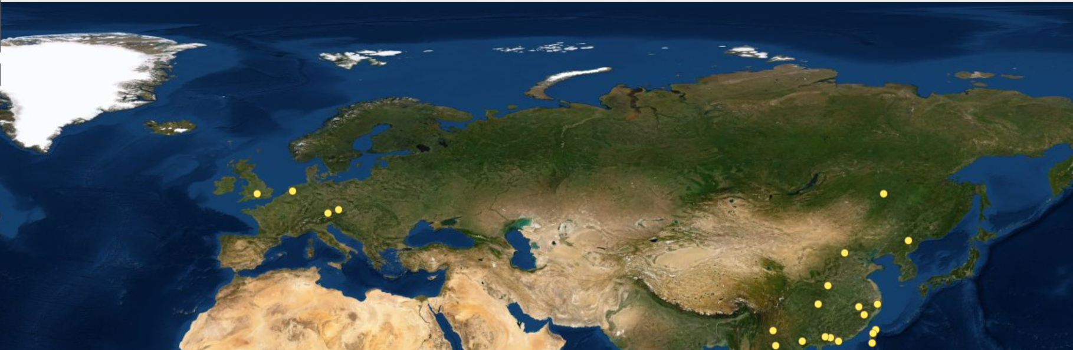
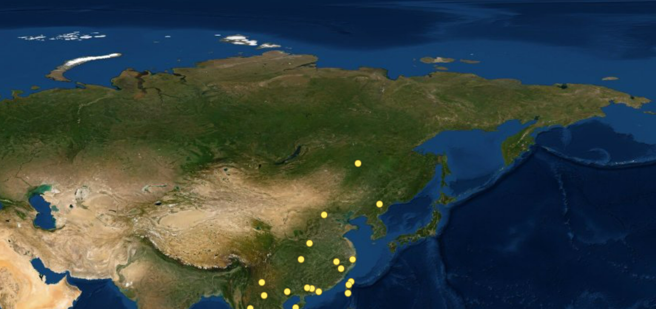
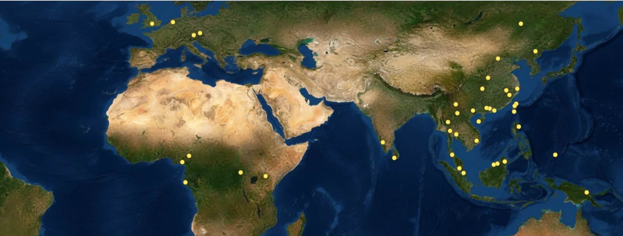
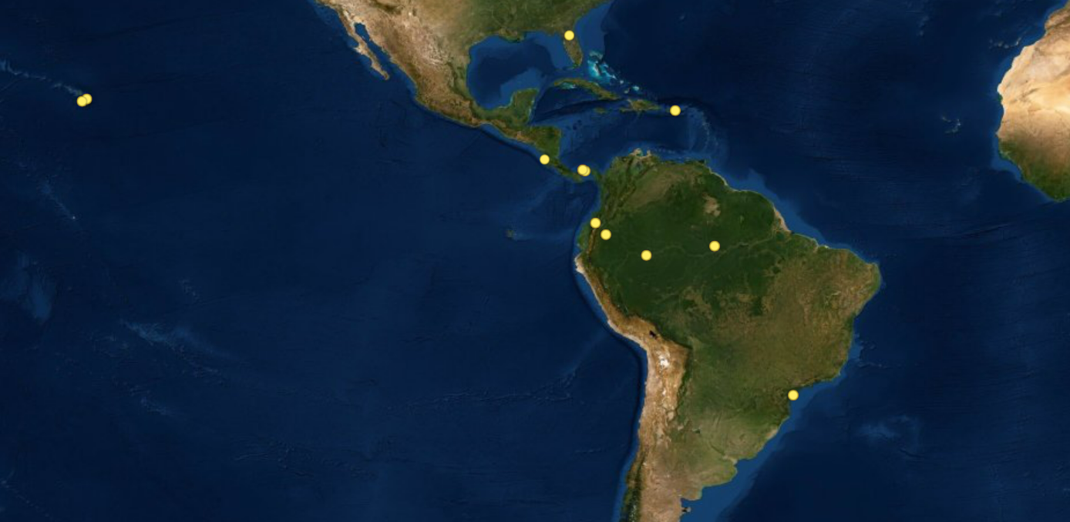
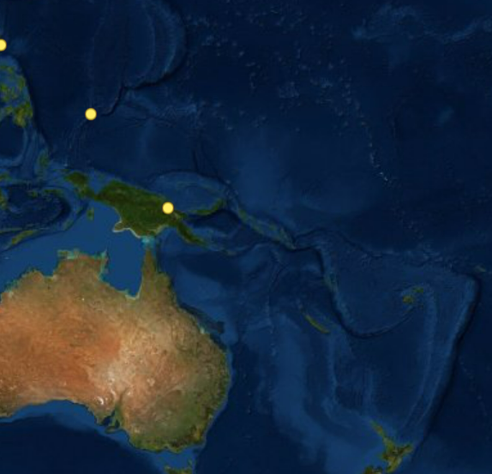
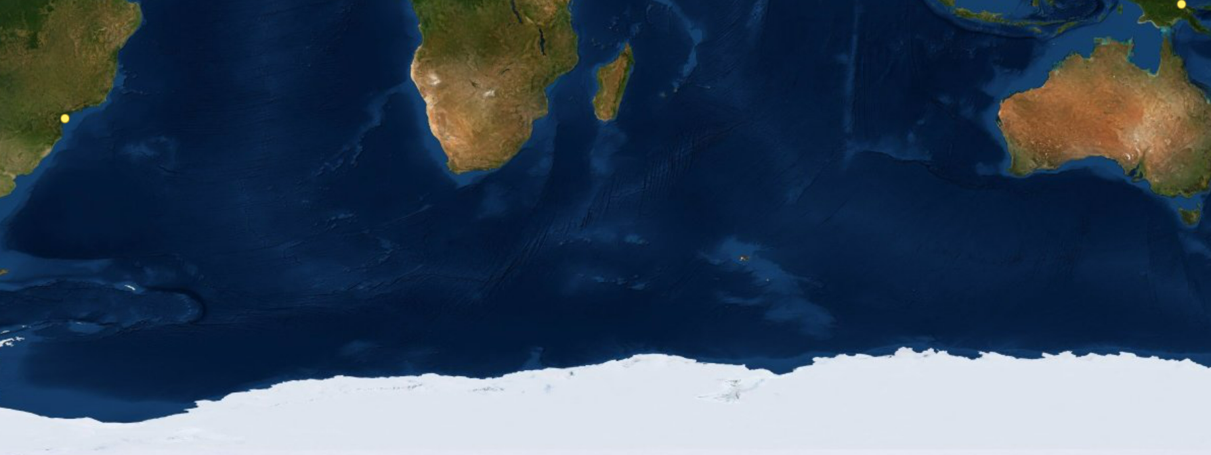
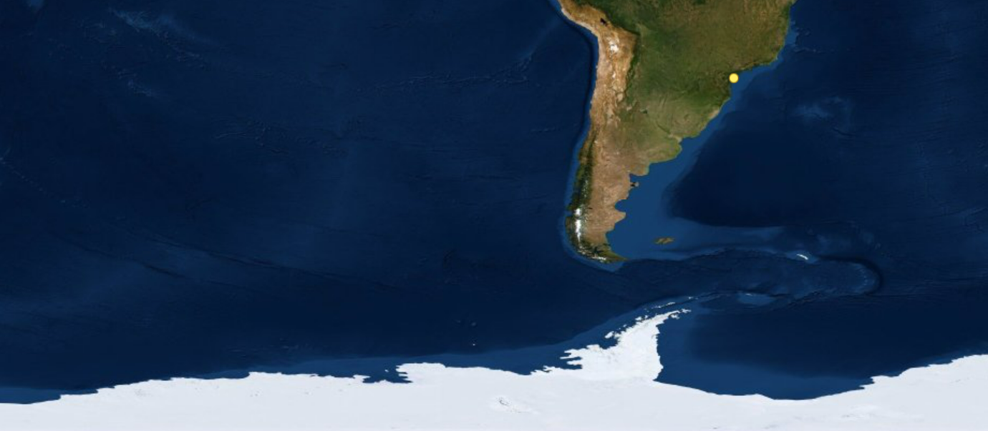
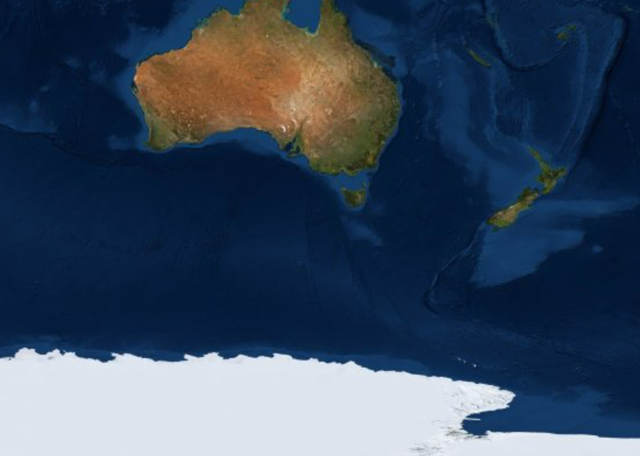
Scotty Creek
Michigan Big Woods
Wytham Woods
Speulderbos
Daxing`angling
Wind River
Wabikon
Haliburton
Traunstein
Zofin
Donglingshan
Dinghushan
Andrews
Niobrara
Harvard Forest
Changbaishan
Yosemite
Tyson
SCBI
UMBC
Baotianman
Indian Cave
SERC
Badagongshan
Gutianshan
Santa Cruz
Utah
Trelease Woods
Lilly Dickey
Heishiding
Tiantongshan
Paint Rock
Ichauway
Nonggang
Baishanzu
Ordway Swisher
Ailaoshan
Fushan
Laupahoehoe
Xishuangbanna
Nanjenshan
Lienhuachih
Palamanui
Luquillo
Doi Inthanon
Hainan
Hong Kong
Kenting
San Emilio
Barro Colorado Island
Mudumalai
Huia Kha Khaeng
Palanan
Ngel Nyaki
Mo Singto
Bidoup
Ngardok
San Lorenzo
Cocoli
Korup
Ituri
Sinharaja
Khao Chong
Danum Valley
La Planada
Yasuní
Manaus
Mpala
Kuala Belalong
Amacayacu
Rabi
Pasoh
Lambir
Wanang
Bukit Timah
Ilha do Cardoso
Starvation Creek
Notes:
78 sites

